Slide 1

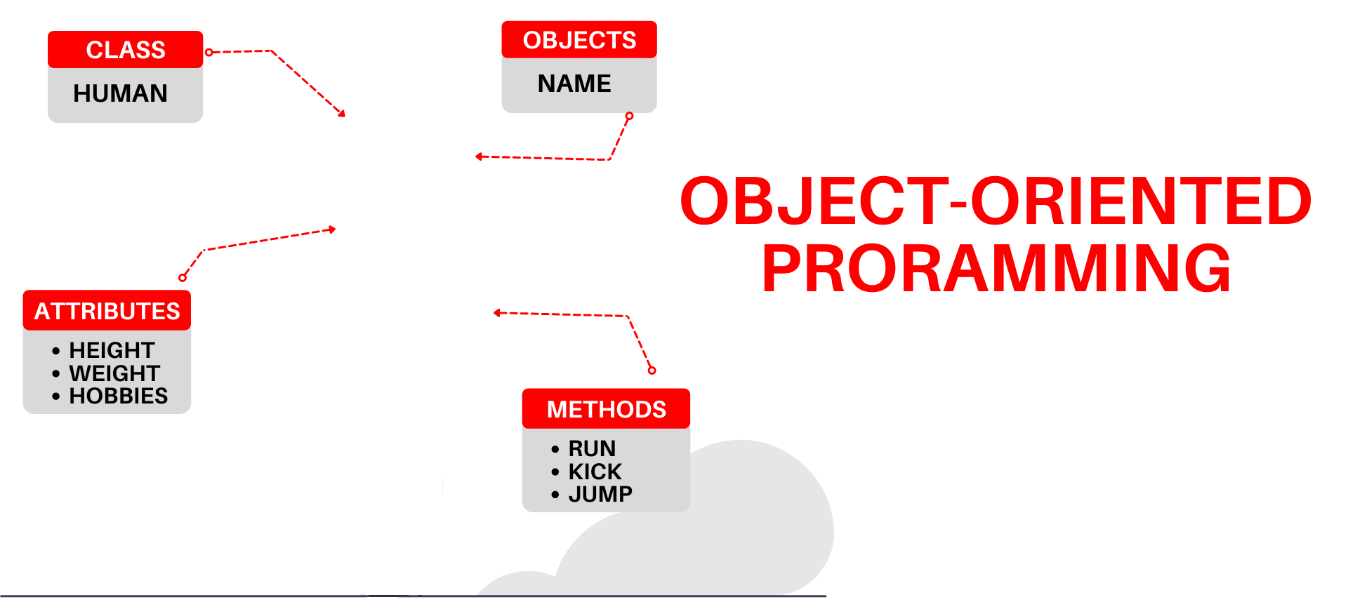

National University of Computer and Emerging Sciences
Spring 2022
Hira Naveed
Lecture # 3 Pointers and DMA

Slide 2
Casting pointers
Pointers have types, so you cannot just do this
int *pi;
double *pd;
pd = pi;
Even if they are both the same size, C++ will still give an error on implicit typecasting

Slide 3

Casting pointers
C++ will let you change the type of a pointer with an explicit cast
int *pi; char *pd;
pd = (char*) pi;
Notes:
int *ip; char* cp; double *dp;

Slide 4
Casting pointers
C++ will let you change the type of a pointer with an explicit cast
int *pi = new int;
*pi = 65;
char *pd;
pd = (char*) pi;
cout<<*pd;
//prints A (ascii 65)
Notes:
int *ip; char* cp; double *dp;

Slide 5
Casting pointers
int *pi = new int; //size 4 bytes
*pi = 131072;
00000000 00000010 00000000 00000000
byte 4 byte 3 byte 2 byte 1
short *pd;
pd = (short*) pi;
cout<<*pd;
//Prints 0 (short size 2 bytes)
Notes:
int *ip; char* cp; double *dp;

Slide 6
Pointer Arithmatic
int x = 25; int *intptr = &x;
intptr++;
What happens now?
Pointer address increases by 4 bytes because the pointer is of type int
Same as intptr + 1

Slide 7
Pointer Arithmatic
int x = 25; int *intptr = &x;
intptr++;
e.g. address of x was 4000
intptr will now be 4004

Slide 8
Pointer Arithmatic
char x =‘4’; char *charptr = &x;
charptr++;
What happens now?
Pointer address increases by 1 bytes because the pointer is of type char
Same as charptr + 1

Slide 9
Pointer Arithmetic

Slide 10
Pointer Arithmatic
int x = 25; int *intptr = &x;
Can we increment the value of x using the pointer?
(*intptr)++;
* Gets the value the pointer points at.
Value of x becomes 26
Brackets needed because * has lower
precedence

Slide 11
Pointer Arithmetic
Only two types of arithmetic operations allowed:
Addition : only integers can be added
Subtraction: only integers be subtracted
Which of the following are valid/invalid?

Slide 12
Relationship Between Pointers and Arrays
Arrays and pointers are closely related
Array name is a constant pointer that stores the starting address of an array
All arrays elements are placed in the consecutive locations

Slide 13
The Relationship Between Arrays and Pointers
Array name is the starting address of array
int vals[] = {4, 7, 11};
cout << vals; // displays 0x4a00
cout << vals[0]; // displays 4
starting address of vals: 0x4a00
4 | 7 | 11

Slide 14
The Relationship Between Arrays and Pointers
Array name can be used as a pointer:
int vals[] = {4, 7, 11};
cout << *vals; // displays 4
Pointer can be used as an array name:
int *valptr = vals;
cout << valptr[1]; // displays 7

Slide 15
Array Access
vals[i] is equivalent to *(vals + i)
No bounds checking performed on array access, whether using array name or a pointer

Slide 16
Array Access
We can access array elements using array index
int num = vals[2]; //value assignment
We can access array elements using pointers
int* p = vals; //address assignment
List is an address, no need for &
The pointer p will contain the address of the first element of array List.
Element vals[2] can be accessed by *( p + 2 )

Slide 17
Array Access
Array elements can be accessed in many ways:
Array access method | Example
array name and [] | vals[2] = 17;
pointer to array and [] | valptr[2] = 17;
array name and subscript arithmetic | *(vals + 2) = 17;
pointer to array and subscript arithmetic | *(valptr + 2) = 17;

Slide 18
Pointers in Expressions
Given:
int vals[]={4,7,11}, *valptr;
valptr = vals;
What is valptr + 1? It means (address in valptr) + (1 * size of an int)
cout << *(valptr+1); //displays 7
cout << *(valptr+2); //displays 11
Must use ( ) as shown in the expressions
This does not change the value of the pointer

Slide 19
Relationship between Arrays and Pointers
void main()
{
int numbers[] = {10,20,30,40,50};
cout<< numbers[0] <<endl;
cout<< numbers <<endl;
cout<< *numbers <<endl;
cout<< *(numbers+1);
}
10
Address e.g., &34234
10
20

Slide 20
Pointer Arithmetic
Operations on pointer variables:
Operation | Example int vals[]={4,7,11}; int *valptr = vals;
++, -- | valptr++; // points at 7 valptr--; // now points at 4
+, - (pointer and int) | cout << *(valptr + 2); // 11
+=, -= (pointer and int) | valptr = vals; // points at 4 valptr += 2; // points at 11
- (pointer from pointer) | cout << valptr–vals; // difference //(number of ints) between valptr // and val

Slide 21
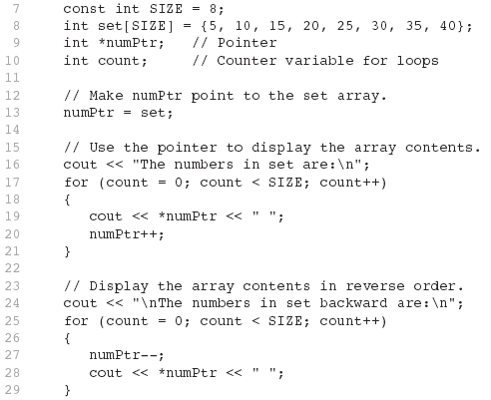


Slide 23
Arrays and Pointers
Array name is the starting address of the array
int A[25]; int *p; int i=0, j=0;
p = A;
p points to A[0]
p + i points to A[i] &A[j]is also the same as p+j A[j] is also the same as *(p+j)

Slide 24
Arrays Decay to Pointers
We learned to pass arrays as arguments to functions
For example, suppose we use this statement to pass the array numbers to the showValues function: showValues(numbers, SIZE);

Slide 25
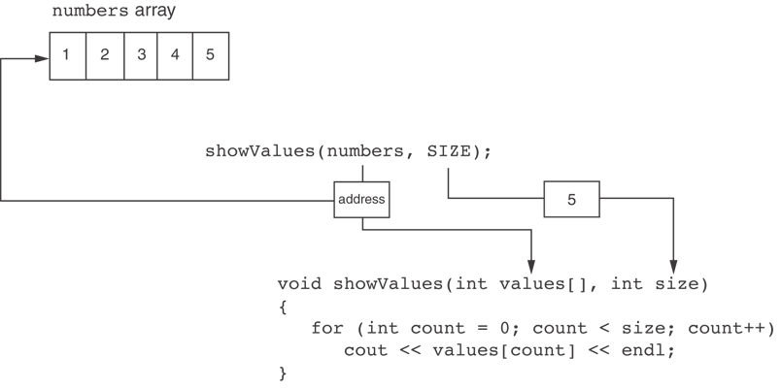
Arrays Decay to Pointers
Arrays passed by value decay into a pointer.
Cannot find size using sizeof() and must pass size as a function parameter
The values parameter, in the showValues function, points to the numbers array.
C++ automatically stores the address of numbers in the values parameter.

Slide 26
Arrays Decay to Pointers
Using sizeof() on an array passed by value to a function will return the size of the pointer
The values parameter, in the showValues function, points to the numbers array.
C++ automatically stores the address of numbers in the values parameter.

Slide 27
Comparing Pointers
Relational operators (<, >=, etc.) can be used to compare addresses in pointers
Comparing addresses in pointers is not the same as comparing contents pointed at by pointers:
if (ptr1 == ptr2) // compares addresses
if (*ptr1 == *ptr2) // compares contents

Slide 28
Comparing Pointers
If one address comes before another address in memory, the first address is considered less than the second address.
In an array, elements are stored in consecutive memory locations, E.g., address of Arr[2] will be smaller than the address of Arr[3] etc.

Slide 29
Accessing 1-Dimensional Array Using Pointers
Address
Data
980
Element 0
We know, Array name denotes the memory address of its first slot.
Example:
int List [ 50 ];
int *Pointer;
Pointer = List;
Other slots of the Array (List [50]) can be accessed using by performing Arithmetic operations on Pointer.
For example the address of (element 4th) can be accessed using:-
int *Value = Pointer + 3;
The value of (element 4th) can be accessed using:-
int Value = *(Pointer + 3);
984
Element 1
988
Element 2
992
Element 3
996
Element 4
1000
Element 5
1004
Element 6
1008
Element 7
1012
Element 8
…
…
…
Element 49

Slide 30
Accessing 1-Dimensional Array
Address
Data
980
Element 0
….
….
int List [ 50 ];
int *Pointer;
Pointer = List; // Address of first Element
int *ptr;
ptr = Pointer + 3; // Address of 4th Element
*ptr = 293; // 293 value store at 4th element address
}
984
Element 1
988
Element 2
992
293
996
Element 4
1000
Element 5
1004
Element 6
1008
Element 7
1012
Element 8
…
…
…
Element 49

Slide 31
Accessing 1-Dimensional Array
We can access all element of List [50] using Pointers and a for loop
Address
Data
980
Element 0
984
Element 1
int List [ 50 ];
int *Pointer;
Pointer = List;
for ( int i = 0; i < 50; i++ )
{
cout << *Pointer;
Pointer++; // Address of next element
}
988
Element 2
992
Element 3
996
Element 4
1000
Element 5
1004
Element 6
1008
Element 7
1012
Element 8
…
…
…
Element 49
This is Equivalent to
for ( int index = 0; index < 50; index++ )
cout << Array [ index ] ;

Slide 32
Accessing 2-Dimensional Array
Address
Data
Note that the statements
int *Pointer;
Pointer = &List [3];
represents that we are accessing the address of 4th slot
In 2-Dimensional array the statements
int List[ 5 ][ 6 ];
int *Pointer;
Pointer = &List [3];
Represents that we are accessing the address of 4th row and 1st column
980
Element 0
984
Element 1
988
Element 2
992
Element 3
996
Element 4
1000
Element 5
1004
Element 6
1008
Element 7
1012
Element 8
…
…
…
Element 49

Slide 33
Accessing 2-Dimensional Array
Column
int List [ 9 ] [ 6 ];
int *ptr;
ptr = &List [3];
To access the address of 4th row 2nd column:
ptr++; // address of 4th row 2nd column
Equivalent to List [3][1] ;
0
1
2
3
4
5
0
300
302
304
306
308
310
Row
1
312
314
316
318
320
322
2
324
326
328
330
332
334
3
336
338
340
342
344
346
4
348
350
352
354
356
358
5
360
362
364
366
368
370
6
372
374
376
378
380
382
7
384
386
388
390
392
394
8
396
398
400
402
404
406
Memory address

Slide 34
Dynamic Memory Allocation
Can also use new to allocate array:
int SIZE = 25; double *arrayPtr = new double[SIZE];
Can then use [] or pointer arithmetic to access array:
for(int i = 0; i < SIZE; i++)
arrayptr[i] = i;
or
for(int i = 0; i < SIZE; i++)
*(arrayptr + i) = i;
Program will terminate if not enough memory available to allocate

Slide 35
// Dynamically allocate memory for 1d array
int N, i;
N = 15;
// Dynamically allocate memory of size N
int *array = new int[N];
// Assign values of allocated memory
for(i = 0; i < N; i++){
cin >> *(array+i); }
for(i = 0; i < N; i++){
cout<<array[i]<<" "; // is equal to cout<<*(array+i);
delete [] array; //deallocate memory

Slide 36
// Dynamically allocate memory for 1d array
int N, i;
cout<<"Enter size of array: ";
cin >> N; //get size from user
// Dynamically allocate memory of size N
int *array = new int[N];
// Assign values of allocated memory
for(i = 0; i < N; i++){
cin >> *(array+i); }
for(i = 0; i < N; i++){
cout<<array[i]<<" "; // is equal to cout<<*(array+i);
delete [] array; //deallocate memory

Slide 37
Creating Dynamic 2D Arrays
Two basic methods:
Using Only one Pointer/One array
Using an Array of Pointers

Slide 38
Dynamic two dimensional arrays
Using One Pointer/One array
Total elements in a 2D Array:
M * N (i.e., rows * cols)
5 rows * 4 columns = 20 elements
Approach:
Allocate 20 elements using dynamic allocation
Use a pointer to point and access those items

Slide 39
Accessing 2-Dimensional Array
Access static array elements using a pointer
int arr[9]={ 1,2,3,
4,5,6,
7,8,9};
int *p = &arr[0];
*(p +(TotCols * rowIndx)+ colIndx);
//equivalent to arr[1][1]
cout<<*(p +(3 * 1)+ 1); //prints 5
//equivalent to arr[2][2]
cout<<*(p +(3 * 2)+ 2); //prints 9

Slide 40
Accessing 2-Dimensional Array
Access dynamic array elements using a pointer
int *p = new int[9];
for(int i=0;i<9;i++){
p[i] = i+1;
}
*(p +(TotCols * rowIndx)+ colIndx);
//equivalent to arr[1][1]
cout<<*(p +(3 * 1)+ 1); //prints 5
//equivalent to arr[2][2]
cout<<*(p +(3 * 2)+ 2); //prints 9

Slide 41
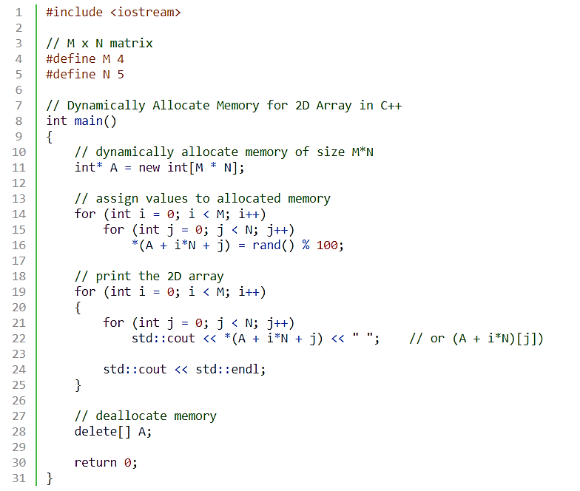
Dynamic 2D Arrays
Notes:
int main(){
int *p= new int[5];
for(int i =0; i<5;i++)
cin>>*(p+i);
for(int i =0; i<5;i++)
cout<<" "<<p[i];
return 0;}

Slide 42
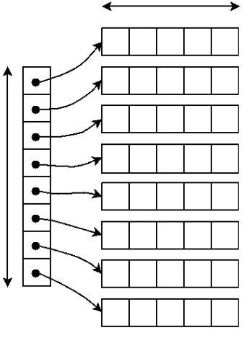
Dynamic 2D Array – Double Pointer
Using a Pointer that points to an Array of Pointer
Total elements in a 2D Array:
M * N i.e (rows * columns)
N
Ptr2D
(Pointer to a Pointer a.k.a double pointer)
M

Slide 43
Dynamic 2D Array – Double Pointer
Can we vary the size of each column in Dynamic 2D Array (using double pointer)
arr → start of array of pointers
*arr → First Address pointed by first row (sub array)
*(*arr) → First value of first array
(*arr)++ → Move to next address in the first array
arr++ → Move to Next row (second array address)
int M=3, N=4;
// Dynamically create array of pointers of size M
int **arr = new int*[M];
// Dynamic allocate memory of size N for each row
for(int i = 0; i < M; i++){
arr[i] = new int[N]
}
// deallocate memory
for(int i = 0; i < M; i++){
delete[] arr[i]; }
delete[] arr;
**
*
*
*
Notes:
The bracket operator is implemented by computing the address of the ith object
base = A = address of A[0] address of element i = base + offset = base + i * sizeof(T) A[i] = reference to element at this address Pointer must know its type to compute addresses using sizeof(T)
Note carefully the distinction between A and A[0]

Slide 44
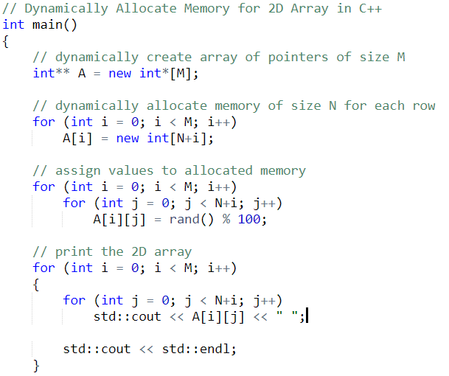
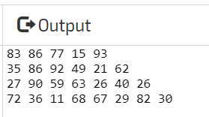
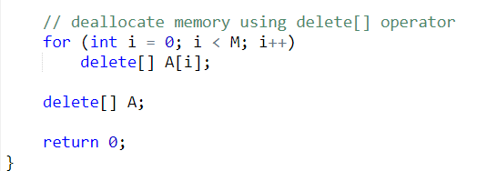
Dynamic 2D Array (Varying Row Size)

Slide 45
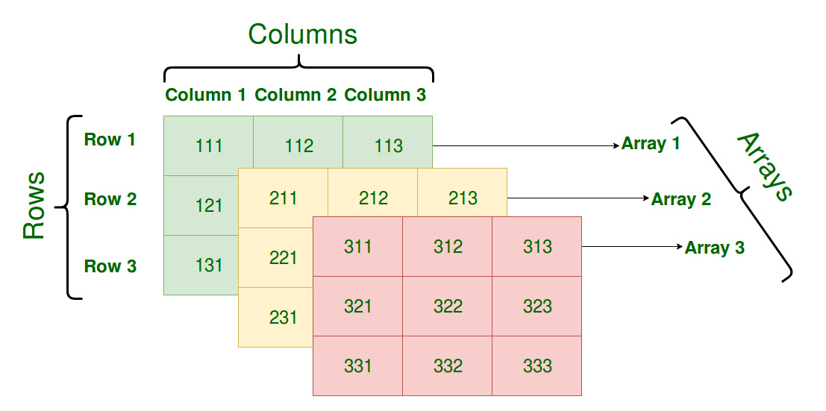
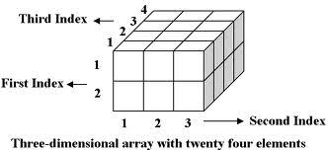
Dynamic 3D Array
Manipulating a 3D Array
Using one pointer
Using a triple pointer

Slide 46
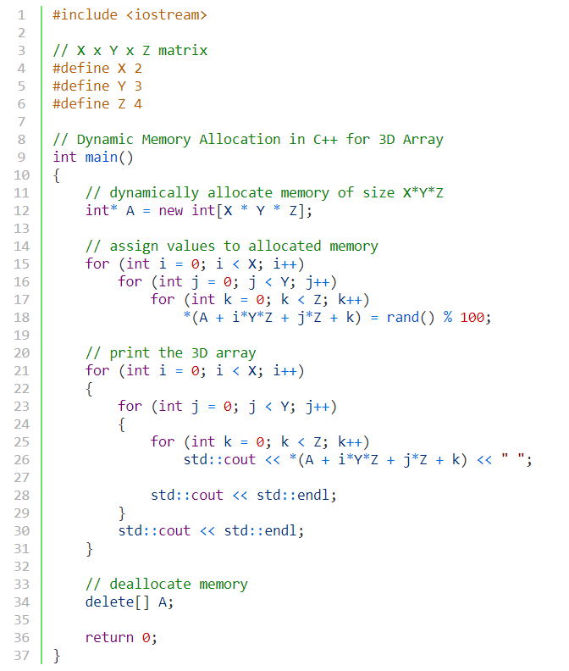
3D Array Using a single pointer

Slide 47
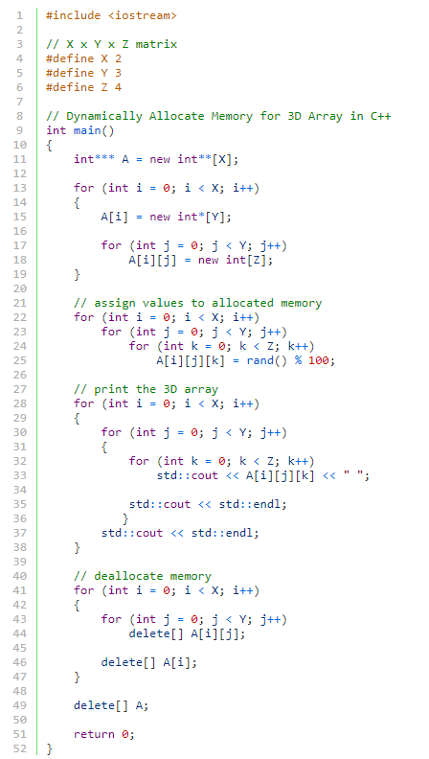
3D Array Using a triple pointer
***
3D array of size 2 x 3 x 4
** | **
*
*
*
*
*
*

Slide 48
C - Strings
#include <string> VS #include <string.h>
#include <cstring>
String class C language header file
Stores strings as char arrays

Slide 49

C - Strings
In C++, a C-string is a sequence of characters stored in consecutive memory locations (array), terminated by a null character.
string name= “Bailey”;
\0 is the NULL character
B | a | i | l | e | y | \0
0 1 2 3 4 5 6

Slide 50
Character Arrays
Be careful, every character array is not a string, however the behavior is similar
char name[7]= {‘B’,’a’,’i’,’l’,’e’,’y’,’y’};
B | a | i | l | e | y | y
0 1 2 3 4 5 6

Slide 51
Character Arrays
Character array initialized with string literal
char name[7]=“Bail”; //always stores /0 at the end
If initializer values of a char array are less than array size, remaining filled with null character – can treat array like a string
B | a | i | l | \0 | \0 | \0
0 1 2 3 4 5 6

Slide 52
Character Arrays
Character array initialized with string literal
char name[]=“Bailey”; //always stores /0 at the end
Array size not specified, char array size = number of characters in string literal + 1 (for \0)
B | a | i | l | e | y | \0
0 1 2 3 4 5 6

Slide 53
Character Arrays
Be careful, every character array is not a string
char name[4]=“Bail”; //always stores /0 at the end
Array size is 4, characters to store are also 4, no space for NULL character – ERROR!!
B | a | i | l | \0
0 1 2 3 4

Slide 54
Character Arrays
char name[]=“Bail”; //always stores /0 at the end
cout<< name; //what happens now?
//Prints Bail
The char array is treated as a string and cout prints characters from the starting address of the array till the null character
B | a | i | l | \0
0 1 2 3 4

Slide 55
Character Arrays
char name[4] = {‘B’,’a’,’i’,’l’};
cout<< name; //what happens now?
//Prints Bail
The char array is treated as a string and cout prints characters from the starting address of the array till the end
B | a | i | l
0 1 2 3

Slide 56
Character Arrays
char name[4] = {‘B’,’a’,’i’,’l’};
cout<< (name+1); //what happens now?
//Prints ail
The char array is treated as a string and cout prints characters from the starting address till the end
B | a | i | l
0 1 2 3

Slide 57
Character Arrays and Char Pointer
* * *
* *
*
* *
* * *
char arr[] = "****";
int i = 1;
for (; i < 3; i++) {
cout << (arr+i) << endl;
}
for (; i >= 1; i--) {
cout << (arr + i) << endl;
}

Slide 58
Character Arrays and Char Pointer
char name[]=“Bail”; //always stores /0 at the end
char *ptr = name;
cout<< ptr; //what happens now?
//Prints Bail
cout prints characters from the pointer address till the null character
B | a | i | l | \0
0 1 2 3 4

Slide 59
Character Arrays and Char Pointer
char name[]=“Bail”; //always stores /0 at the end
char *ptr = name;
cout<< ptr;
ptr++;
cout prints characters from the starting address of the array till the null character, print ail
B | a | i | l | \0
0 1 2 3 4

Slide 60
Character Arrays and Char Pointer
void match(char* str, char ch, int size){
for(int i=0;i<size;i++){
if(*str == ch){
cout << str;
break;
}
else
str++; }}
void main() {
char arr[] = "some string";
match(arr,'e',sizeof(arr));
}
e string

Slide 61
Character Arrays and Char Pointer
// Copying string using Pointers
char* str1 = “Self-conquest is the greatest victory.”;
char str2[80]; //empty string
char* src = str1;
char* dest = str2;
while( *src ) //until null character,
*dest++ = *src++; //copy from src to dest
*dest = ‘\0’; //terminate dest
cout << str2 << endl; //display str2

Slide 62
Cin vs Getline
Input can be performed by the cin object.
const int SIZE = 21;
char name[SIZE];
cin >> name;
This code allows the user to enter a string (with no whitespace characters) into the name array

Slide 63
Cin vs Getline
C-string input can be performed by the getline function of the cin object.
const int SIZE = 21;
char name[SIZE];
cin.getline(name, SIZE);
This code allows the user to enter a string (with whitespace characters) into the name array

Slide 64
Cin vs Getline
const int SIZE = 21;
char name[SIZE];
cin.getline(name, SIZE);
first argument tells getline where to store the string input.
second argument indicates maximum length of the string, including the null terminator

Slide 65
Cin vs Getline
const int SIZE = 21;
char name[SIZE];
cin.getline(name, SIZE);
In this example, the SIZE constant is equal to 21,
cin will read 20 characters, or until the user presses the Enter key, whichever comes first.
cin will automatically append the null terminator to the end of the string.

Slide 66
Cin vs Getline
const int SIZE = 21;
char name[SIZE];
cin.getline(name, SIZE);
If you are using cin and cin.getline together, you would have to clear the input buffer inbetween, to remove the null character inserted by cin
Use cin.ignore(); for this.

Slide 67
Cin vs Getline
If you are using cin and cin.getline together, you would have to clear the input buffer inbetween
Use cin.ignore(); for this.
int x, arr[3];
cin>>x;
cin.ignore(); //clears the input stream buffer
cin.getline(arr,3);

Slide 68
Pointers to Constants
const int a = 5;
int *foo = &a;
ERROR!!
If we want to store the address of a constant in a pointer, then we need to store it in a pointer-to-const
const int *foo= &a;

Slide 69
Pointers to Constants
This is a READ-ONLY pointer.
const int *foo= &a;
*foo = 26; //ERROR

Slide 70
Pointers to Constants
const int a = 5;
const int *foo= &a;
Be careful:
const is applied to the thing that foo points to, not foo itself
The pointer itself is not constant

Slide 71
Pointers to Constants
const int a = 5;
const int *foo= &a;
The data type
foo points to
Because foo is a pointer to a const, the compiler will not allow us to write code that changes the thing that foo points to.

Slide 72
Pointers to Constants
const int a = 5;
const int *foo= &a;
*foo = NULL;
Like standard pointers you can also set a pointer to constant NULL

Slide 73
Pointers to Constants
const int a = 5;
const int *foo= &a;
*foo = new int;
Like standard pointers you can also use a pointer to constant for dynamic memory allocation

Slide 74
Pointers to Constants
Example: Suppose we have the following definitions: const int SIZE = 6; const double payRates[SIZE] = { 18.55, 17.45, 12.85, 14.97, 10.35, 18.89 };
In this code, payRates is an array of constant doubles.

Slide 75
Pointers to Constants
A pointer to const parameter can also receive the address of a non-constant item.
Suppose we wish to pass the payRates array to a function? Here's an example of how we can do it.
void displayPayRates(const double *rates, int size) { for (int count = 0; count < size; count++) { cout << "Pay rate " << (count + 1) << " is $" << *(rates + count) << endl; } }
The parameter, rates, is a pointer to const double.

Slide 76
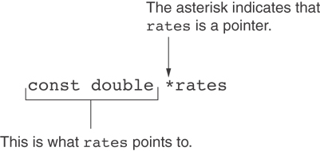
Declaration of a Pointer to Constant

Slide 77
Constant Pointers
A constant pointer is a pointer that is initialized with an address, and cannot point to anything else
Example int value = 22; int * const ptr = &value;

Slide 78
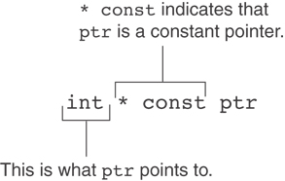
Constant Pointers

Slide 79
Constant Pointers to Constants
A constant pointer to a constant is:
a pointer that points to a constant
a pointer that cannot point to anything except what it is pointing to
Example: const int value = 22; const int * const ptr = &value;

Slide 80
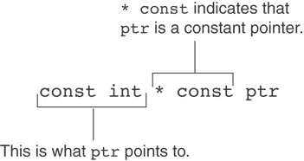
Constant Pointers to Constants

Slide 81
Constant Pointers to Constants
A constant pointer to a constant is:
a pointer that points to a constant
a pointer that cannot point to anything except what it is pointing to
Example: int value = 22; const int * const ptr = &value;
Pointer to const can also point to non-constant

Slide 82
Pointers as Function Parameters
A pointer can be a function parameter
void getNum(int *ptr){//definition
………
}
Use pointers as function parameters and addresses as arguments
Pass address using & operator
int num = 7;
getNum(&num); //function call

Slide 83
Pointers as Function Parameters
A pointer can be a function parameter
void getNum(int *ptr){//definition
………
}
Can also use pointer as an argument
int num = 7; int *p = &num;
getNum(p); //function call

Slide 84
Pointers as Function Parameters
void func(int *num)
{
*num = 10;
}
void main()
{ int n = 5;
cout<<"Before: n = "<<n<<endl;
func(&n);
cout<<"After: n = "<<n<<endl;
}
n = 5 | 2000
num = 2000 | 2400

Slide 85
Pointers as Function Parameters
void func(int *num)
{
*num = 10;
}
void main()
{ int n = 5;
cout<<"Before: n = "<<n<<endl;
func(&n);
cout<<"After: n = "<<n<<endl;
}
n = 5 | 2000
num = 2000 | 2400

Slide 86
Pointers as Function Parameters
void func(int *num)
{
*num = 10;
}
void main()
{ int n = 5;
cout<<"Before: n = "<<n<<endl;
func(&n);
cout<<"After: n = "<<n<<endl;
}
n = 10 | 2000
num = 2000 | 2400

Slide 87
Pointers as Function Parameters
void func(int *num)
{
*num = 10;
}
void main()
{ int n = 5;
cout<<"Before: n = "<<n<<endl;
func(&n);
cout<<"After: n = "<<n<<endl;
}
n = 10 | 2000
 | 2400
Before: n = 5
After: n = 10

Slide 88
Pointers as Function Parameters
Do not use & while passing an array
Array name is already an address
void compDouble(int* Ar)
{
…………… }
void main()
{ int Arr[10]={0,1,2,3,4,5,6,7,8,9};
compDouble(&Arr); //ERROR
}

Slide 89
Pointers as Function Parameters
Do not use & while passing an array
Array name is already an address
void compDouble(int* Ar)
{
…………… }
void main()
{ int Arr[10]={0,1,2,3,4,5,6,7,8,9};
compDouble(Arr); //Correct way
}

Slide 90
Pointers as Function Parameters
void compDouble(int* Ar)
{ for(int i=0;i<10;i++)
{ *Ar=(*Ar)*2;
Ar++;
} }
void main()
{ int Arr[10]={0,1,2,3,4,5,6,7,8,9};
compDouble(Arr);
}

Slide 91
Pointers as Function Parameters
A function with a pointer parameter, called with pointer argument
Case 1: If you change the value at the address the pointer points to, the change will remain even after the function has returned
Case 2: If you change the value of the pointer (address), the change will not be retained after the function ends
This is because the function has a copy of the pointer

Slide 92
Case 1 Example
void func(int *num)
{
*num = 30;
}
void main()
{ int n = 5; int *p = &n;
cout<<"Before: n = "<<n<<endl;
func(p);
cout<<"After: n = "<<n<<endl;
}
Before: n = 5
After: n = 30

Slide 93
Case 2 Example
int gl = 93;
void func(int *num)
{
num = &gl;
}
void main()
{ int n = 5; int *p = &n;
cout<<"Before: n = "<<n<<endl;
func(p);
cout<<"After: n = "<<n<<endl;
}
Before: n = 5
After: n = 5

Slide 94
Pointers as Function Parameters
Two ways to change the value of a pointer (address) in a function with a pointer parameter
Pointer to pointer (double pointer)
Reference to pointer (aliasing)

Slide 95
Pointer to Pointer Function Parameter
int gl = 95;
void func(int **num)
{
*num = &gl;
}
void main()
{ int n = 5; int *ptr = &n;
cout<<"Before = "<< *ptr <<endl;
func(&ptr);
cout<<"After = "<< *ptr <<endl;
}
n = 5 | 2000
ptr = 2000 | 2400

Slide 96
Pointer to Pointer Function Parameter
int gl = 95;
void func(int **num)
{
*num = &gl;
}
void main()
{ int n = 5; int *ptr = &n;
cout<<"Before = "<< *ptr <<endl;
func(ptr);
cout<<"After = "<< *ptr <<endl;
}
n = 5 | 2000
ptr = 2000 | 2400
num = 2400 | 3210

Slide 97
Pointer to Pointer Function Parameter
int gl = 95;//address 1500
void func(int **num)
{
*num = &gl;
}
void main()
{ int n = 5; int *ptr = &n;
cout<<"Before = "<< *ptr <<endl;
func(ptr);
cout<<"After = "<< *ptr <<endl;
}
n = 5 | 2000
ptr = 2000 | 2400
num = 2400 | 3210

Slide 98
Pointer to Pointer Function Parameter
int gl = 95;//address 1500
void func(int **num)
{
*num = &gl;
}
void main()
{ int n = 5; int *ptr = &n;
cout<<"Before = "<< *ptr <<endl;
func(ptr);
cout<<"After = "<< *ptr <<endl;
}
n = 5 | 2000
ptr = 1500 | 2400
num = 2400 | 3210

Slide 99
Pointer to Pointer Function Parameter
int gl = 95;//address 1500
void func(int **num)
{
*num = &gl;
}
void main()
{ int n = 5; int *ptr = &n;
cout<<"Before = "<< *ptr <<endl;
func(ptr);
cout<<"After = "<< *ptr <<endl;
}
n = 5 | 2000
ptr = 1500 | 2400
 | 3210
Before = 5
After = 95

Slide 100
Reference to Pointer Function Parameter
Recall reference parameters
void fun(int &ref) {
ref = 20;
}
void main() {
int x = 10;
fun(x);
cout<<"New value of x is "<< x;
}
10 | = x = ref
The reference parameter
ref is just another name
for x. Like an alias/nickname

Slide 101
Reference to Pointer Function Parameter
Recall reference parameters
void fun(int &ref) {
ref = 20;
}
void main() {
int x = 10;
fun(x);
cout<<"New value of x is "<< x;
//prints 20
}
20 | = x = ref
The reference parameter
ref is just another name
for x. Like an alias/nickname

Slide 102
Reference to Pointer Function Parameter
Recall reference parameters
void fun(int &ref) {
ref = 20;
}
void main() {
int x = 10;
fun(x);
cout<<"New value of x is "<< x;
//prints 20
}
Modifications in variables passed by reference are retained, even after function returns

Slide 103
Reference to Pointer Function Parameter
int gl = 95;//address 1500
void func(int *&num)
{
num = &gl;
}
void main()
{ int n = 5; int *ptr = &n;
cout<<"Before = "<< *ptr <<endl;
func(ptr);
cout<<"After = "<< *ptr <<endl;
}
n = 5 | 2000
ptr = 2000 | 2400

Slide 104
Reference to Pointer Function Parameter
int gl = 95;//address 1500
void func(int *&num)
{
num = &gl;
}
void main()
{ int n = 5; int *ptr = &n;
cout<<"Before = "<< *ptr <<endl;
func(ptr);
cout<<"After = "<< *ptr <<endl;
}
n = 5 | 2000
ptr = 2000 num = | 2400
num is just another
name for ptr.

Slide 105
Reference to Pointer Function Parameter
int gl = 95;//address 1500
void func(int *&num)
{
num = &gl;
}
void main()
{ int n = 5; int *ptr = &n;
cout<<"Before = "<< *ptr <<endl;
func(ptr);
cout<<"After = "<< *ptr <<endl;
}
n = 5 | 2000
ptr = 1500 num = | 2400
Before = 5
After = 95
num is just another
name for ptr.

Slide 106
Pointer to Pointer(**) vs Reference to Pointer(*&)
Reference is just another name(alias), pointer is a variable that stores an address
References are simpler to use, does most of the work for you
However, references cannot be NULL, pointers can
Cannot make an array of references

Slide 107
Quiz Questions

Slide 108
int main() {
// use the following dimensions of an array
int N = 4;
int M = 4;
// Write code for dynamic allocation of a 2D array named A, using a double pointer[1 marks]
int** A = new int* [N];
for (int i = 0; i < N; i++) {
A[i] = new int[M];
}
// Assume that you have populated the array as following.
for (int i = 0; i < N; ++i) {
for (int j = 0; j < M; ++j) {
A[i][j] = i + 5;
}
}

Slide 109
//Use pointer arithmetic and print the output of the following statements [5 marks]
//Assume starting address of this dynamically allocated array of pointers is 100
cout << **A << endl; // write your output here: 5
cout << *(*A + 2) + 1 << endl; // write your output here: 6
cout << **A + 100 << endl; // write your output here: 105
cout << *(*(A + 2) + 3) + 5 << endl; // write your output here: 12
cout << *A + 3;// write your output here: starting address of first integer array + 12 bytes
// write your code to De-allocate the dynamic memory of the 2D array A [1 marks]
for (int i = 0; i < N; i++) {
delete [] A[i];
}
delete[] A;
A = NULL;
return 0;
}

Slide 110
Q2.Write the output of the following code[3 marks]
void funct(int* x, int* y, int*& z)
{
z = x;
x = y;
*x = 200;
}
int main() {
int i = 10;
int j = 20;
int* p = &j;
funct(&i, &j, p);
cout << "i is = " << i << endl;// write your output here: 10
cout << "j is = " << j << endl;// write your output here: 200
cout << "p is = " << --(*p) << endl;// write your output here: 9
}

Slide 111
(a) Given the following code snippet, create a pointer to the given pointer (ptr) named ptr_to_ptr, then print the value stored in variable ‘x’ using this newly created ptr_to_ptr: [1 Mark]
int x = 10;
int* ptr = &x;
int **ptr_to_ptr=&ptr;
cout<<**ptr_to_ptr;
(b) Given the following code snippet, what will be the output? [1 Marks]
int x = 100;
int y = 200;
int *p = &x, *q = &y;
p = q;
cout<<*p; 200

Slide 112
(c) Given the following code snippet, what will be the output? [1 Marks]
char arr[20];
int i;
for ( i = 0; i < 10; i++ )
*(arr + i) = 65 + i; // ‘65’ is ASCII code of ‘A’
*(arr + i) = ‘\0’;
cout << arr;
ABCDEFGHIJ

Slide 113
(d) Given the following code snippet, what will be the output? [2 Marks]
char *ptr;
char arr[ ] = “abcdefgh”;
ptr = arr;
ptr + = 5;
cout << ptr;
fgh
(e) Given the following code snippet, what will be the output? (Assuming memory address of variable ‘x’ is 01434CC3.) [2 Marks]
int x = 50;
int *ptr = &x;
ptr = ptr + 1;
cout << ptr; 01434CC7

